Slide 1
OpenACC: More Science Less Programming
Sunita Chandrasekaran
Assistant Professor, Computer & Information Sciences
University of Delaware, Newark, DE, USA
Director of OpenACC User Adoption
June 07, 2018
1st HPC Summer School 2018
Universidad de los Andes, Bogotá, from June 5th to 9th
ACK: NVIDIA TEACHING KIT

Slide 2
OpenACC Directives are designed for
1
2
Scientists to help do
more science and less programming
Performance portability on
CPUs, GPUs and other platforms
Notes:
Simple, Powerful, Portable

Slide 3
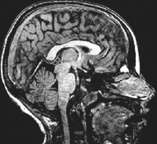


main()
{
<serial code>
#pragma acc kernels
//automatically runs on GPU
{
<parallel code>
}
}
University of Illinois
PowerGrid- MRI Reconstruction
OpenACC
Simple | Powerful | Portable
Fueling the Next Wave of
Scientific Discoveries in HPC
70x Speed-Up
2 Days of Effort
8000+
Developers
using OpenACC
RIKEN Japan
NICAM- Climate Modeling
7-8x Speed-Up
5% of Code Modified
http://www.cray.com/sites/default/files/resources/OpenACC_213462.12_OpenACC_Cosmo_CS_FNL.pdf
http://www.hpcwire.com/off-the-wire/first-round-of-2015-hackathons-gets-underway
http://on-demand.gputechconf.com/gtc/2015/presentation/S5297-Hisashi-Yashiro.pdf
http://www.openacc.org/content/experiences-porting-molecular-dynamics-code-gpus-cray-xk7
Notes:
So we know that developers drive innovation in HPC. There is a programming tool that we believe will fuel the next wave of developers in HPC. OpenACC.
Industry standard programming interface that makes it simpler than ever to run existing codes on the accelerator.
relying on a compiler to do most of the hard work, to automatically run code on the GPU.
Targets developers, mostly domain scientists w/o any computer science background. No parallel programming background.
With OpenACC, domain scientists don’t have to master parallel programming.
By putting simple hints into the code that a compiler can understand, the compiler does parallel programming on behalf of the developer.
<refer to the green box>
Today, over 8000 developers are using OpenACC.
Many of those who have used OpenACC have had great success.
Examples underscore the fact that OpenACC is simple. Only 5% of the code was modified. Only 2 days of effort for PowerGrid.
At the same time, OpenACC is powerful. 7-8x speedup on their code. Even up to 70x over CPU code.
PowerGrid - MRI Reconstruction Information
=========
Advanced model for MRI reconstruction.
Two approaches:
1. DFT - O(N^2), simple but compute intensive. Use for extremely under-sampled acquisitions. Would be a new approach. Less radiation dosage.
2. Gridding DFT approximation, O(N log(N)), several steps; predominant approach used in existing scanners today. Less computationally intensive.
With OpenACC, they feel that DFT is now possible
DFT is 88% forward and inverse Fourier Transforms on CPU. App threaded for 2 cores but doesn't scale.
OpenACC: In DFT routines added 2 lines and achieved a 70x speedup
DFT run (reconstruct 3000 images) on BW ran in 21.2 hours last night vs. 9 months on CPU!
Take-aways:
2 lines of code. Using DFT is now feasible; could move from research to diagnostic with some refinement.
Followed up with Paresh on this, this is the number of PGI Accelerator Compiler licenses, not including Crays and not taking into account that some are cluster-wide licenses that could cover multiple users.

Slide 4
University of Delaware
Accelerating Chemical Shift of Protein Structures
main()
{
<serial code>
#pragma acc kernels
//automatically runs on GPU
{
<parallel code>
}
}
OpenACC
Simple | Powerful | Portable
Fueling the Next Wave of
Scientific Discoveries in HPC
67x Speed-Up
14 months effort
Undergraduate students with minimum parallel programming background

Slide 5


OpenACC Directives
#pragma acc data copyin(a,b) copyout(c) { ... #pragma acc parallel
{
#pragma acc loop gang vector
for (i = 0; i < n; ++i) {
z[i] = x[i] + y[i];
...
}
}
...
}
Manage Data Movement
Incremental
Single source
Initiate Parallel Execution
Interoperable
Performance portable
CPU, GPU, MIC
Optimize
Loop Mappings
Notes:
Are you new to OpenACC? Here is a quick primer. [Here’s is quick refresher.]
You can take large existing applications, and incrementally parallelize compute-intensive loops and routines for offloading to an Accelerator.
OpenACC allows you to keep one copy of your source code, because the directives are ignored by any compiler that doesn’t understand them – that means your code remains completely portable for use with any standard C, C++ or Fortran compiler.
OpenACC is designed to be interoperable with explicit accelerator parallel programming models like CUDA and OpenCL, which means you can directly call library routines written in those programming models from your OpenACC program and if needed you can code the really important parts of your program in those lower-level models if you need to.
OpenACC was designed from the outset to be performance portable, so that you can write programs that will map efficiently to multi-core CPUs, GPUs from NVIDIA or AMD, or many integrated core (MIC) accelerators like the upcoming Knights Landing processors from Intel.

Slide 6



Accelerated Computing 10x Performance & 5x Energy Efficiency for HPC
GPU Accelerator
Optimized for
Parallel Tasks
CPU
Optimized for
Serial Tasks

Slide 7


What is Heterogeneous Programming?
Application Code
Compute-Intensive Functions
Rest of Sequential
CPU Code
A few % of Code
A large % of Time
GPU
CPU
+

Slide 8
Portability & Performance
Portability
Accelerated Libraries
High performance with little or no code change
Limited by what libraries are available
Compiler Directives
High Level: Based on existing languages; simple, familiar, portable
High Level: Performance may not be optimal
Parallel Language Extensions
Greater flexibility and control for maximum performance
Often less portable and more time consuming to implement
Performance

Slide 9
Code for Portability & Performance
Libraries
Implement as much as possible using portable libraries
Directives
Use directives for rapid and portable development
Languages
Use lower level languages for important kernels

Slide 10
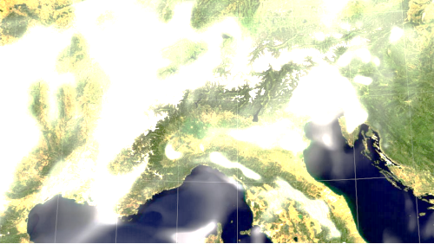
OpenACC growing Momentum
Wide Adoption Across Key HPC Codes
silica IFPEN, RMM-DIIS on P100
silica IFPEN, RMM-DIIS on P100
ANSYS Fluent, Gaussian, VASP
Key Codes Globally
COSMO, IFS(ESCAPE), NICAM, ICON, MPAS
GTC
XGC
ACME
FLASH
LSDalton
VASP, silica IFPEN, RMM-DIIS on P100
Gordon Bell Finalist
CAM-SE on Sunway Taihulight
* OpenACC port covers more VASP routines than CUDA, OpenACC port planned top down, with complete analysis of the call tree, OpenACC port leverages improvements in latest VASP Fortran source base
3 of Top 5 HPC Applications Use OpenACC
CAAR Codes Use OpenACC
OpenACC Dominates in Climate & Weather
Notes:
Center for Accelerated Application Readiness (CAAR)
VASP material science
Gaussian Quantum Chemistry
ANSYS Fluent, CFD

Slide 11
Identify Available Parallelism
Express Parallelism
Express Data Movement
Optimize Loop Performance

Slide 12
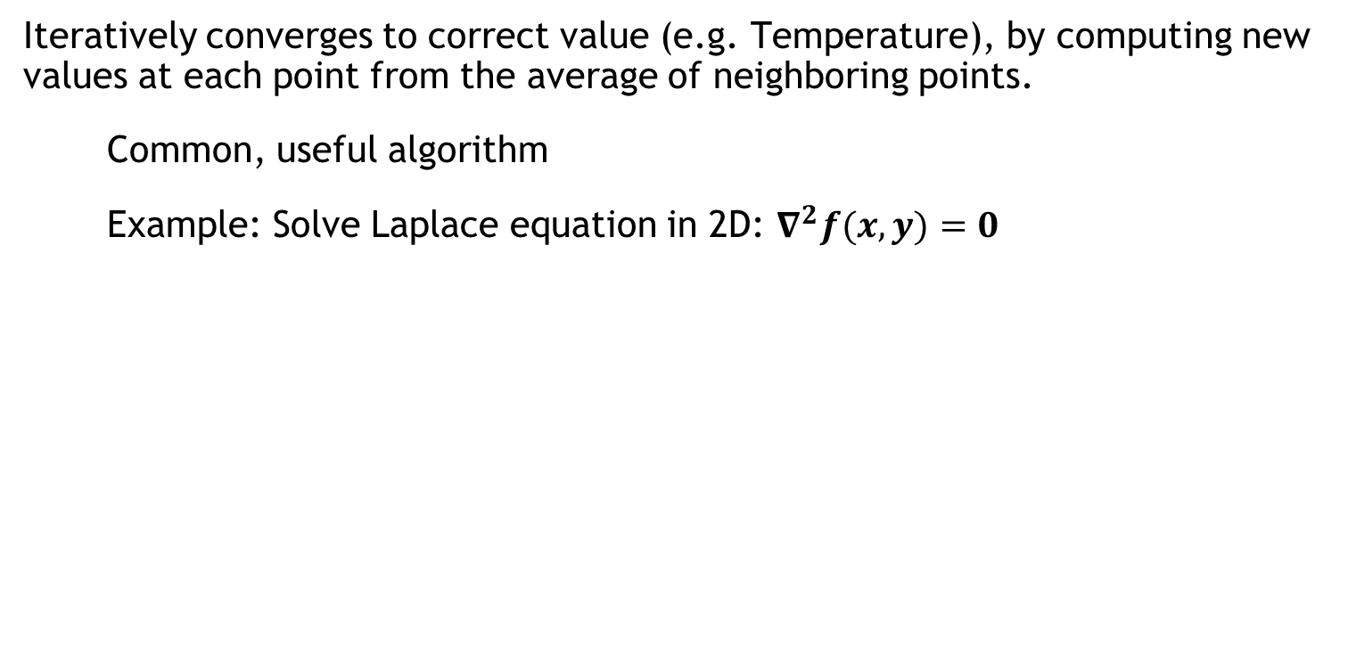
Example: Jacobi Iteration
Iteratively converges to correct value (e.g. Temperature), by computing new values at each point from the average of neighboring points.
Common, useful algorithm
Example: Solve Laplace equation in 2D: $∇^{2}f(x,y)=0$
A(i,j+1)
A(i-1,j)
A(i+1,j)
A(i,j)
$$A_{k+1}\left(i,j\right)=\frac{A_{k}(i−1,j)+A_{k}\left(i+1,j\right)+A_{k}\left(i,j−1\right)+A_{k}\left(i,j+1\right) }{4}$$
A(i,j-1)

Slide 13
Jacobi Iteration: C Code
Iterate until converged
while ( err > tol && iter < iter_max ) {
err=0.0;
for( int j = 1; j < n-1; j++) {
for(int i = 1; i < m-1; i++) {
Anew[j][i] = 0.25 * (A[j][i+1] + A[j][i-1] +
A[j-1][i] + A[j+1][i]);
err = max(err, abs(Anew[j][i] - A[j][i]));
}
}
for( int j = 1; j < n-1; j++) {
for( int i = 1; i < m-1; i++ ) {
A[j][i] = Anew[j][i];
}
}
iter++;
}
Iterate across matrix elements
Calculate new value from neighbors
Compute max error for convergence
Swap input/output arrays

Slide 14
Identify Available Parallelism
Express Parallelism
Express Data Movement
Optimize Loop Performance

Slide 15
Identify Parallelism
Data dependency between iterations.
while ( err > tol && iter < iter_max ) {
err=0.0;
for( int j = 1; j < n-1; j++) {
for(int i = 1; i < m-1; i++) {
Anew[j][i] = 0.25 * (A[j][i+1] + A[j][i-1] +
A[j-1][i] + A[j+1][i]);
err = max(err, abs(Anew[j][i] - A[j][i]));
}
}
for( int j = 1; j < n-1; j++) {
for( int i = 1; i < m-1; i++ ) {
A[j][i] = Anew[j][i];
}
}
iter++;
}
Independent loop iterations
Independent loop iterations

Slide 16
Identify Available Parallelism
Express Parallelism
Express Data Movement
Optimize Loop Performance

Slide 17
OpenACC kernels Directive
The kernels directive identifies a region that may contain loops that the compiler can turn into parallel kernels.
#pragma acc kernels
{
for(int i=0; i<N; i++)
{
x[i] = 1.0;
y[i] = 2.0;
}
for(int i=0; i<N; i++)
{
y[i] = a*x[i] + y[i];
}
}
The compiler identifies 2 parallel loops and generates 2 kernels.
kernel 1
kernel 2
Notes:
Note: The term “kernel” should be explained briefly, but will be explained in more depth in the second lecture.

Slide 18
Parallelize with OpenACC kernels
while ( err > tol && iter < iter_max ) {
err=0.0;
#pragma acc kernels
{
for( int j = 1; j < n-1; j++) {
for(int i = 1; i < m-1; i++) {
Anew[j][i] = 0.25 * (A[j][i+1] + A[j][i-1] +
A[j-1][i] + A[j+1][i]);
err = max(err, abs(Anew[j][i] - A[j][i]));
}
}
for( int j = 1; j < n-1; j++) {
for( int i = 1; i < m-1; i++ ) {
A[j][i] = Anew[j][i];
}
}
}
iter++;
}
Look for parallelism within this region.

Slide 19
Building the code
$ pgcc -fast -ta=tesla -Minfo=all laplace2d.c
main:
40, Loop not fused: function call before adjacent loop
Generated vector sse code for the loop
51, Loop not vectorized/parallelized: potential early exits
55, Generating copyout(Anew[1:4094][1:4094])
Generating copyin(A[:][:])
Generating copyout(A[1:4094][1:4094])
Generating Tesla code
57, Loop is parallelizable
59, Loop is parallelizable
Accelerator kernel generated
57, #pragma acc loop gang /* blockIdx.y */
59, #pragma acc loop gang, vector(128) /* blockIdx.x threadIdx.x */
63, Max reduction generated for error
67, Loop is parallelizable
69, Loop is parallelizable
Accelerator kernel generated
67, #pragma acc loop gang /* blockIdx.y */
69, #pragma acc loop gang, vector(128) /* blockIdx.x threadIdx.x */

Slide 20
Intel Xeon E5-2698 v3 @ 2.30GHz (Haswell)
vs.
NVIDIA Tesla K40
Why did OpenACC slow down here?

Slide 21
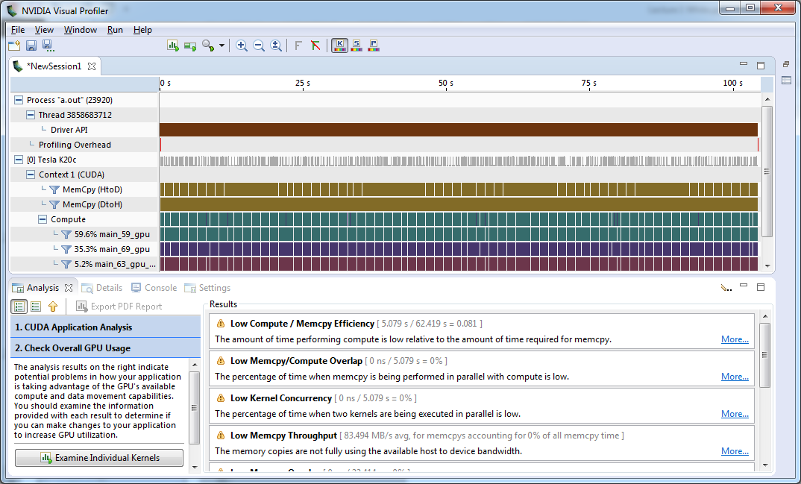
Very low Compute/Memcpy ratio
Compute | 5 seconds
Memory Copy | 62 seconds

Slide 22
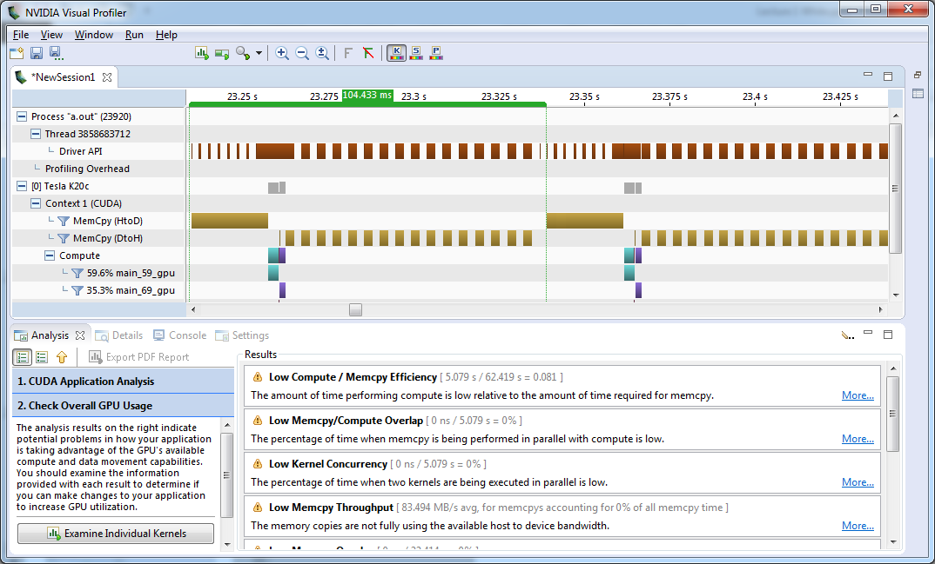
104ms/iteration
PCIe Copies

Slide 23
Excessive Data Transfers
while ( err > tol && iter < iter_max ) {
err=0.0;
...
}
#pragma acc kernels
for( int j = 1; j < n-1; j++) {
for(int i = 1; i < m-1; i++) {
Anew[j][i] = 0.25 * (A[j][i+1] +
A[j][i-1] + A[j-1][i] +
A[j+1][i]);
err = max(err, abs(Anew[j][i] –
A[j][i]);
}
}
...
A, Anew resident on host
A, Anew resident on accelerator
Copy
These copies happen every iteration of the outer while loop!
Copy
A, Anew resident on host
A, Anew resident on accelerator
Notes:
STOP FOR QUESTIONS.
How might you address this problem?

Slide 24
Identifying Data Locality
while ( err > tol && iter < iter_max ) {
err=0.0;
#pragma acc kernels
{
for( int j = 1; j < n-1; j++) {
for(int i = 1; i < m-1; i++) {
Anew[j][i] = 0.25 * (A[j][i+1] + A[j][i-1] +
A[j-1][i] + A[j+1][i]);
err = max(err, abs(Anew[j][i] - A[j][i]));
}
}
for( int j = 1; j < n-1; j++) {
for( int i = 1; i < m-1; i++ ) {
A[j][i] = Anew[j][i];
}
}
}
iter++;
}
Does the CPU need the data between these loop nests?
Does the CPU need the data between iterations of the convergence loop?

Slide 25
Identify Available Parallelism
Express Parallelism
Express Data Movement
Optimize Loop Performance

Slide 26
Data regions
The data directive defines a region of code in which GPU arrays remain on the GPU and are shared among all kernels in that region.
#pragma acc data
{
#pragma acc kernels
...
#pragma acc kernels
...
}
Arrays used within the data region will remain on the GPU until the end of the data region.
Data Region

Slide 27
Data Clauses
copy ( list ) | Allocates memory on GPU and copies data from host to GPU when entering region and copies data to the host when exiting region.
copyin ( list ) | Allocates memory on GPU and copies data from host to GPU when entering region.
copyout ( list ) | Allocates memory on GPU and copies data to the host when exiting region.
create ( list ) | Allocates memory on GPU but does not copy.
present ( list ) | Data is already present on GPU from another containing data region.
deviceptr( list ) | The variable is a device pointer (e.g. CUDA) and can be used directly on the device.

Slide 28
Express Data Locality
Copy A to/from the accelerator only when needed.
Create Anew as a device temporary.
#pragma acc data copy(A) create(Anew)
while ( err > tol && iter < iter_max ) {
err=0.0;
#pragma acc kernels
{
for( int j = 1; j < n-1; j++) {
for(int i = 1; i < m-1; i++) {
Anew[j][i] = 0.25 * (A[j][i+1] + A[j][i-1] +
A[j-1][i] + A[j+1][i]);
err = max(err, abs(Anew[j][i] - A[j][i]));
}
}
for( int j = 1; j < n-1; j++) {
for( int i = 1; i < m-1; i++ ) {
A[j][i] = Anew[j][i];
}
}
}
iter++;
}

Slide 29
Rebuilding the code
$ pgcc -fast -acc -ta=tesla -Minfo=all laplace2d.c
main:
40, Loop not fused: function call before adjacent loop
Generated vector sse code for the loop
51, Generating copy(A[:][:])
Generating create(Anew[:][:])
Loop not vectorized/parallelized: potential early exits
56, Accelerator kernel generated
56, Max reduction generated for error
57, #pragma acc loop gang /* blockIdx.x */
59, #pragma acc loop vector(256) /* threadIdx.x */
56, Generating Tesla code
59, Loop is parallelizable
67, Accelerator kernel generated
68, #pragma acc loop gang /* blockIdx.x */
70, #pragma acc loop vector(256) /* threadIdx.x */
67, Generating Tesla code
70, Loop is parallelizable
Notes:
$ pgcc -fast -ta=tesla -Minfo=all laplace2d.c
main:
40, Loop not fused: function call before adjacent loop
Generated vector sse code for the loop
51, Loop not vectorized/parallelized: potential early exits
55, Generating copyout(Anew[1:4094][1:4094])
Generating copyin(A[:][:])
Generating copyout(A[1:4094][1:4094])
Generating Tesla code
57, Loop is parallelizable
59, Loop is parallelizable
Accelerator kernel generated
57, #pragma acc loop gang /* blockIdx.y */
59, #pragma acc loop gang, vector(128) /* blockIdx.x threadIdx.x */
63, Max reduction generated for error
67, Loop is parallelizable
69, Loop is parallelizable
Accelerator kernel generated
67, #pragma acc loop gang /* blockIdx.y */
69, #pragma acc loop gang, vector(128) /* blockIdx.x threadIdx.x */

Slide 30
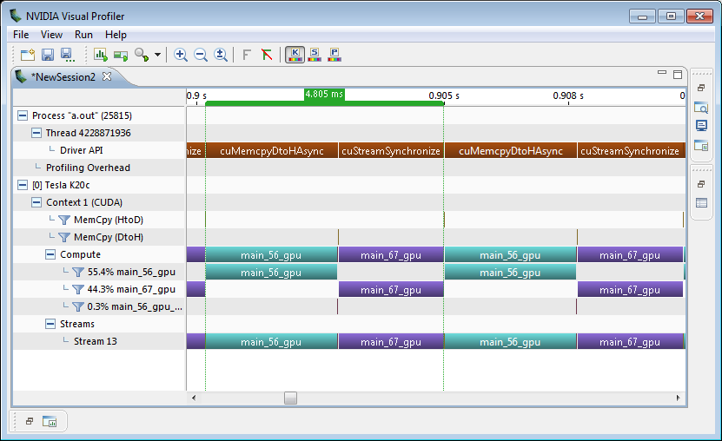
Visual Profiler: Data Region
Was 104ms
Iteration 1
Iteration 2

Slide 31
Intel Xeon E5-2698 v3 @ 2.30GHz (Haswell)
vs.
NVIDIA Tesla K40

Slide 32

Introducing the New OpenACC Toolkit
Free Toolkit Offers Simple & Powerful Path to Accelerated Computing
PGI Compiler
Free OpenACC compiler for academia
NVProf Profiler
Easily find where to add compiler directives
GPU Wizard
Identify which GPU libraries can jumpstart code
Code Samples
Learn from examples of real-world algorithms
http://developer.nvidia.com/openacc
Documentation
Quick start guide, Best practices, Forums
Notes:
We think every domain scientist should have access to this powerful tool. So what we are announcing today is a new toolkit called, the NVIDIA OpenACC Toolkit.
It’s everything a developer needs for quick on-ramp to accelerated computing.
The foundation of this toolkit is a free OpenACC compiler.
Up to now, anyone who wanted to try OpenACC would have had to pay for the compiler.
In partnering with PGI, one of the leading compiler vendor in HPC, we’ve eliminated that barrier to access. Free for academia.
Toolkit includes NVProf profiler which helps developers locate where to insert the compiler hints
Lots of samples of how to use OpenACC in real-world algorithms so developer can just cut and paste
Quick start guide, best practices guide. Other tools that help make developer experience as seamless as possible
We’re really excited about this toolkit. Developers can spend less time programming, and more time doing science
Starting 7/13, any developer can download the toolkit from URL

Slide 33
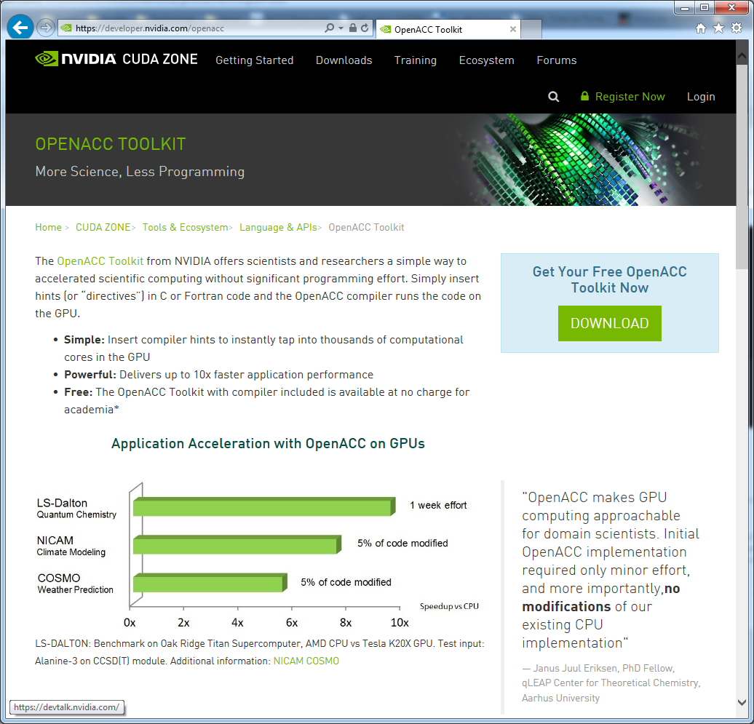
Download the OpenACC Toolkit
Go to https://developer.nvidia.com/openacc

Slide 34
Windows/Mac Developers
The OpenACC Toolkit is only available on Linux, however…
The PGI compiler is available on Mac and Windows from http://www.pgroup.com/support/trial.htm
You should still register for the OpenACC Toolkit to get the 90 day license.
The CUDA Toolkit contains the libraries and profiling tools that will be used in this course.
https://developer.nvidia.com/cuda-zone
The OpenACC Programming Guide is available from http://bit.ly/openacc-guide
Obtaining all examples and guides from the toolkit will still require downloading the full OpenACC toolkit.

Slide 35
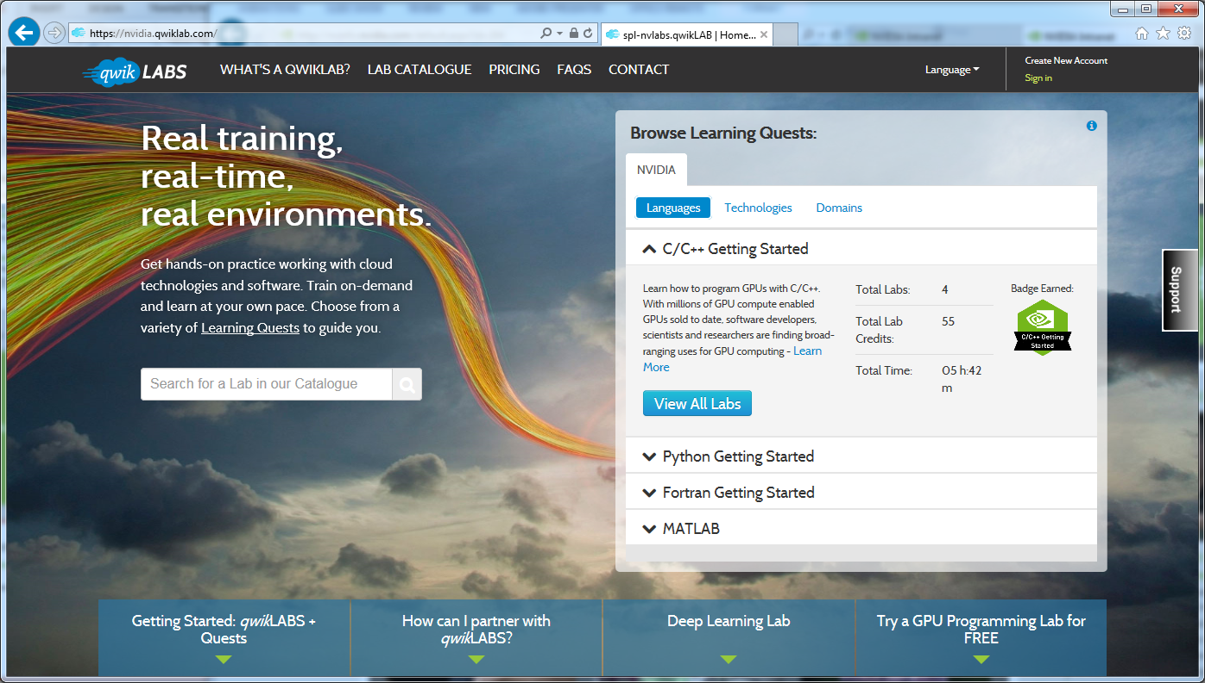
Getting access
Sign In or Create a New Account
Go to nvidia.qwiklab.com, log-in or create an account
Notes:
This lab is browser-based and should take you roughly 1 hour.

Slide 36
Where to find help
OpenACC Course Recordings - https://developer.nvidia.com/openacc-course
OpenACC on StackOverflow - http://stackoverflow.com/questions/tagged/openacc
OpenACC Toolkit - http://developer.nvidia.com/openacc
Additional Resources:
Parallel Forall Blog - http://devblogs.nvidia.com/parallelforall/
GPU Technology Conference - http://www.gputechconf.com/
OpenACC Website - http://openacc.org/

Slide 37





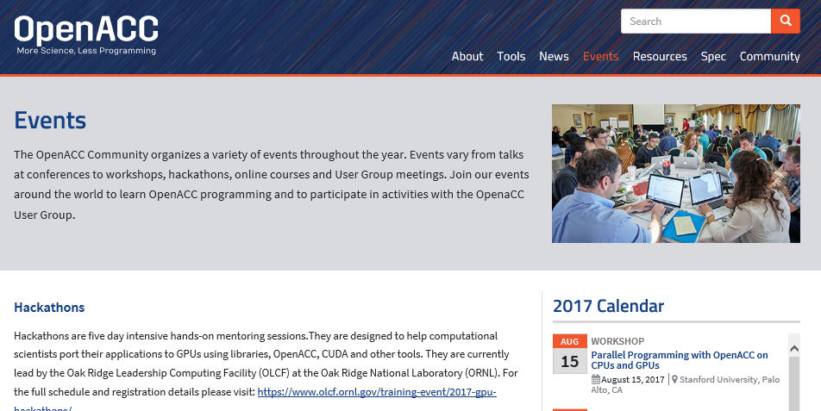

OPENACC Resources
Guides ● Talks ● Tutorials ● Videos ● Books ● Spec ● Code Samples ● Teaching Materials ● Events ● Success Stories ● Courses ● Slack ● Stack Overflow
Resources
https://www.openacc.org/resources
Success Stories https://www.openacc.org/success-stories
FREE
Compilers
Compilers and Tools https://www.openacc.org/tools
Events
https://www.openacc.org/events
https://www.openacc.org/community#slack
Notes:
Resources for various things relating to OpenACC. The two recommended, free compilers for OpenACC are PGI and GCC. OpenACC is a new edition to GCC, and all of OpenACC’s features may not be supported yet.

Slide 38
OpenACC Slack community
Sign up!
Join 340 other slack members !
Get your answers from
scientific developers, compiler developers
and users ☺

Slide 39

An OpenACC Textbook recently published – November 2017
Available via Amazon and other sites
Example codes, chapter solutions available
https://github.com/OpenACCUserGroup/openacc_concept_strategies_book

Slide 40
www.OPEnacc.org
Read More at

